Slide 1




Syntax and Semantics
Basic
Formal Methods of Describing Syntax
Attitude Grammars
Dynamic Semantics
fb.com/angeles.sti.edu
(045) 625-7667
MADE MORE
TO
BE

Slide 2
Basics
Syntax
Semantics
Sentence
Lexeme
Tokens
fb.com/angeles.sti.edu
(045) 625-7667
MADE MORE
TO
BE
Notes:
Syntax – the form of the expressions, statements, and program units of a programming language
When referring to a programming language, the syntax is a set of rules for grammar and spelling. In other words, it means using character structures that a computer can interpret. For example, if a user tries to execute a command without proper syntax, it generates a syntax error, usually causing the program to fail.
Semantics – the meaning of the expressions, statements, and program units of a programming
language
• Lexemes – include the numeric literals, operators, and special words of a programming language
• Token – a category of the lexemes of a language

Slide 3
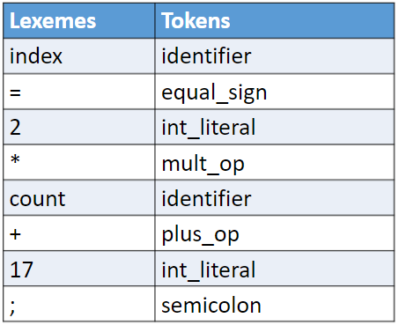
index = 2 * count + 17;
fb.com/angeles.sti.edu
(045) 625-7667
MADE MORE
TO
BE

Slide 4
Grammars
Regular
Context - free
fb.com/angeles.sti.edu
(045) 625-7667
MADE MORE
TO
BE

Slide 5
Also known as BNF
Developed by John Backous and Peter Naur
Backous-Naur Form
Metalanguage – a language used to describe another language
Ex. <assign> → <var> = <expression>
fb.com/angeles.sti.edu
(045) 625-7667
MADE MORE
TO
BE

Slide 6
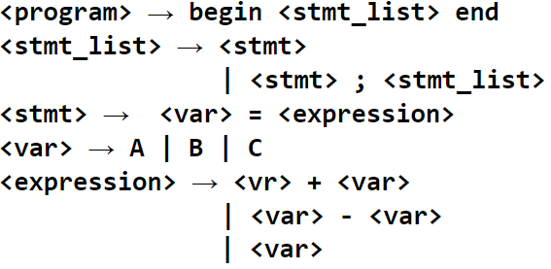
Sample Grammar 1
fb.com/angeles.sti.edu
(045) 625-7667
MADE MORE
TO
BE

Slide 7
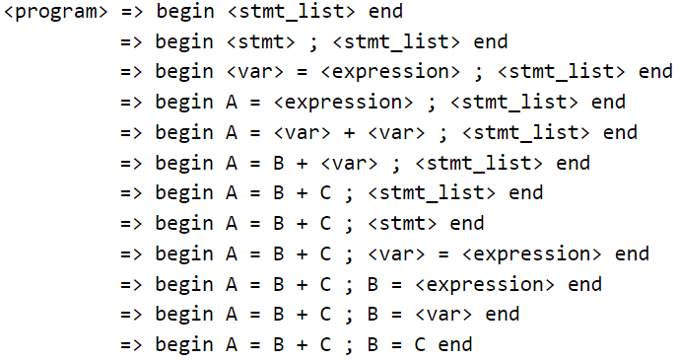
Derivation
fb.com/angeles.sti.edu
(045) 625-7667
MADE MORE
TO
BE

Slide 8
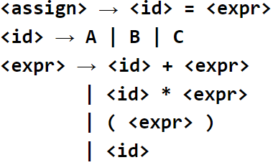
Sample Grammar 2
fb.com/angeles.sti.edu
(045) 625-7667
MADE MORE
TO
BE

Slide 9
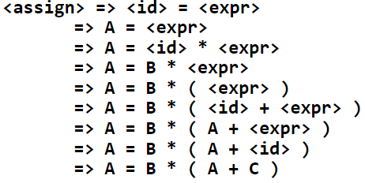
Sentence:
Leftmost Derivation:
fb.com/angeles.sti.edu
(045) 625-7667
MADE MORE
TO
BE

Slide 10
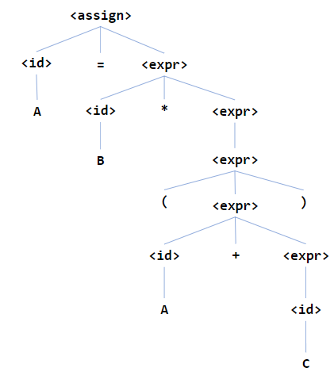
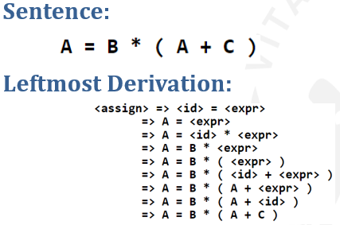
Parse Tree
fb.com/angeles.sti.edu
(045) 625-7667
MADE MORE
TO
BE

Slide 11
Parse Tree
fb.com/angeles.sti.edu
(045) 625-7667
MADE MORE
TO
BE

Slide 12
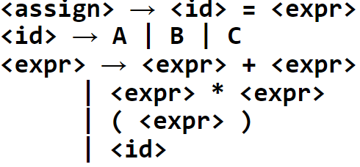
Ambiguous Grammar
fb.com/angeles.sti.edu
(045) 625-7667
MADE MORE
TO
BE

Slide 13
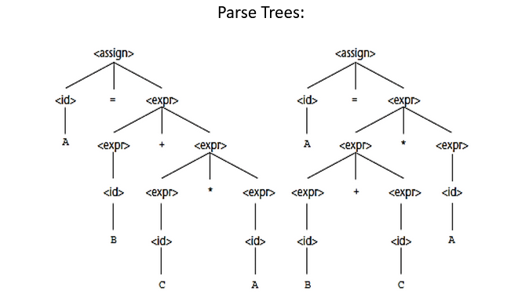
A = B + C * A
fb.com/angeles.sti.edu
(045) 625-7667
MADE MORE
TO
BE

Slide 14
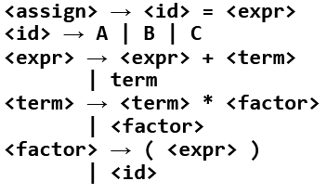
Operator Precedence
fb.com/angeles.sti.edu
(045) 625-7667
MADE MORE
TO
BE

Slide 15
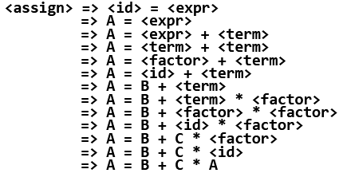
Sentence:
Leftmost Derivation:
fb.com/angeles.sti.edu
(045) 625-7667
MADE MORE
TO
BE

Slide 16
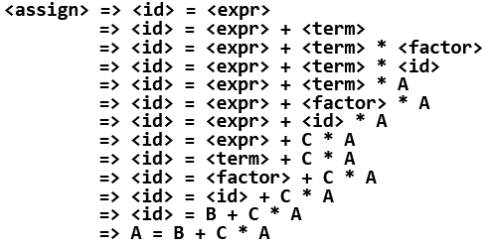
Sentence:
Leftmost Derivation:
fb.com/angeles.sti.edu
(045) 625-7667
MADE MORE
TO
BE

Slide 17
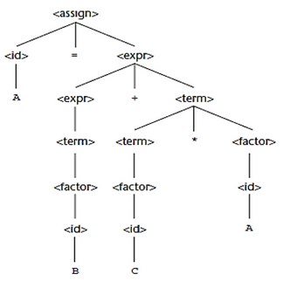
A = B + C * A
fb.com/angeles.sti.edu
(045) 625-7667
MADE MORE
TO
BE

Slide 18
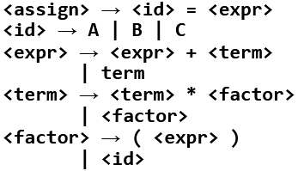
Operator Associativity
fb.com/angeles.sti.edu
(045) 625-7667
MADE MORE
TO
BE

Slide 19
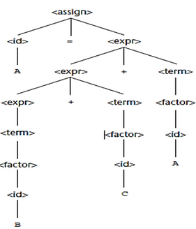
A = B + C + A
fb.com/angeles.sti.edu
(045) 625-7667
MADE MORE
TO
BE

Slide 20
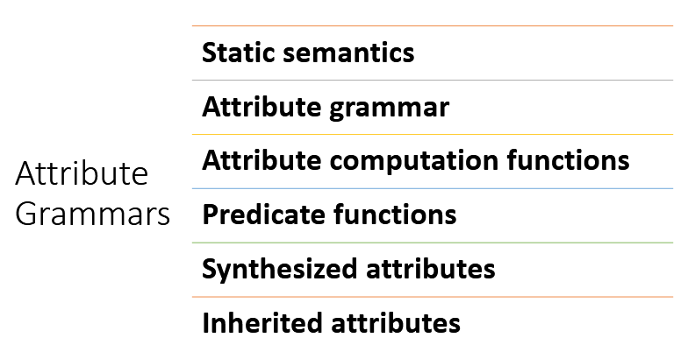
fb.com/angeles.sti.edu
(045) 625-7667
MADE MORE
TO
BE

Slide 21
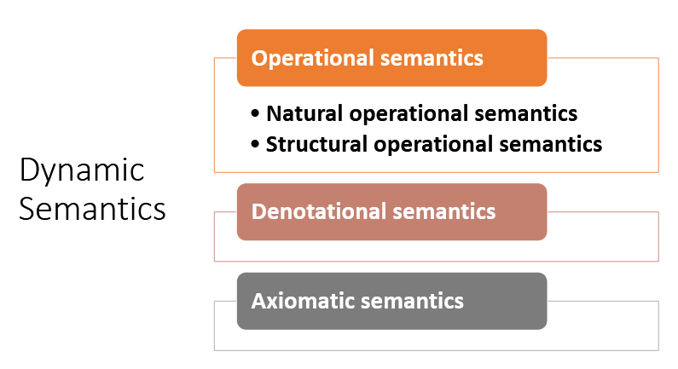
fb.com/angeles.sti.edu
(045) 625-7667
MADE MORE
TO
BE

